Slide 1
Forecasting HICP for Norway
By Nishit Pabari, Renuka Nair, William Cardona

Slide 2
Harmonized Index of Consumer Prices (HICP)
The Harmonized Index of Consumer Prices (HICP) is a list of the final costs paid by consumers for items in a basket of common goods
It is a composite measure of inflation in the European Union
Consumer goods here refer to sugar, jam, honey and other confectionery items
Data sourced from FRED (economic research website)
Data frequency is monthly starting from 2010 till 2021 (August)

Slide 3
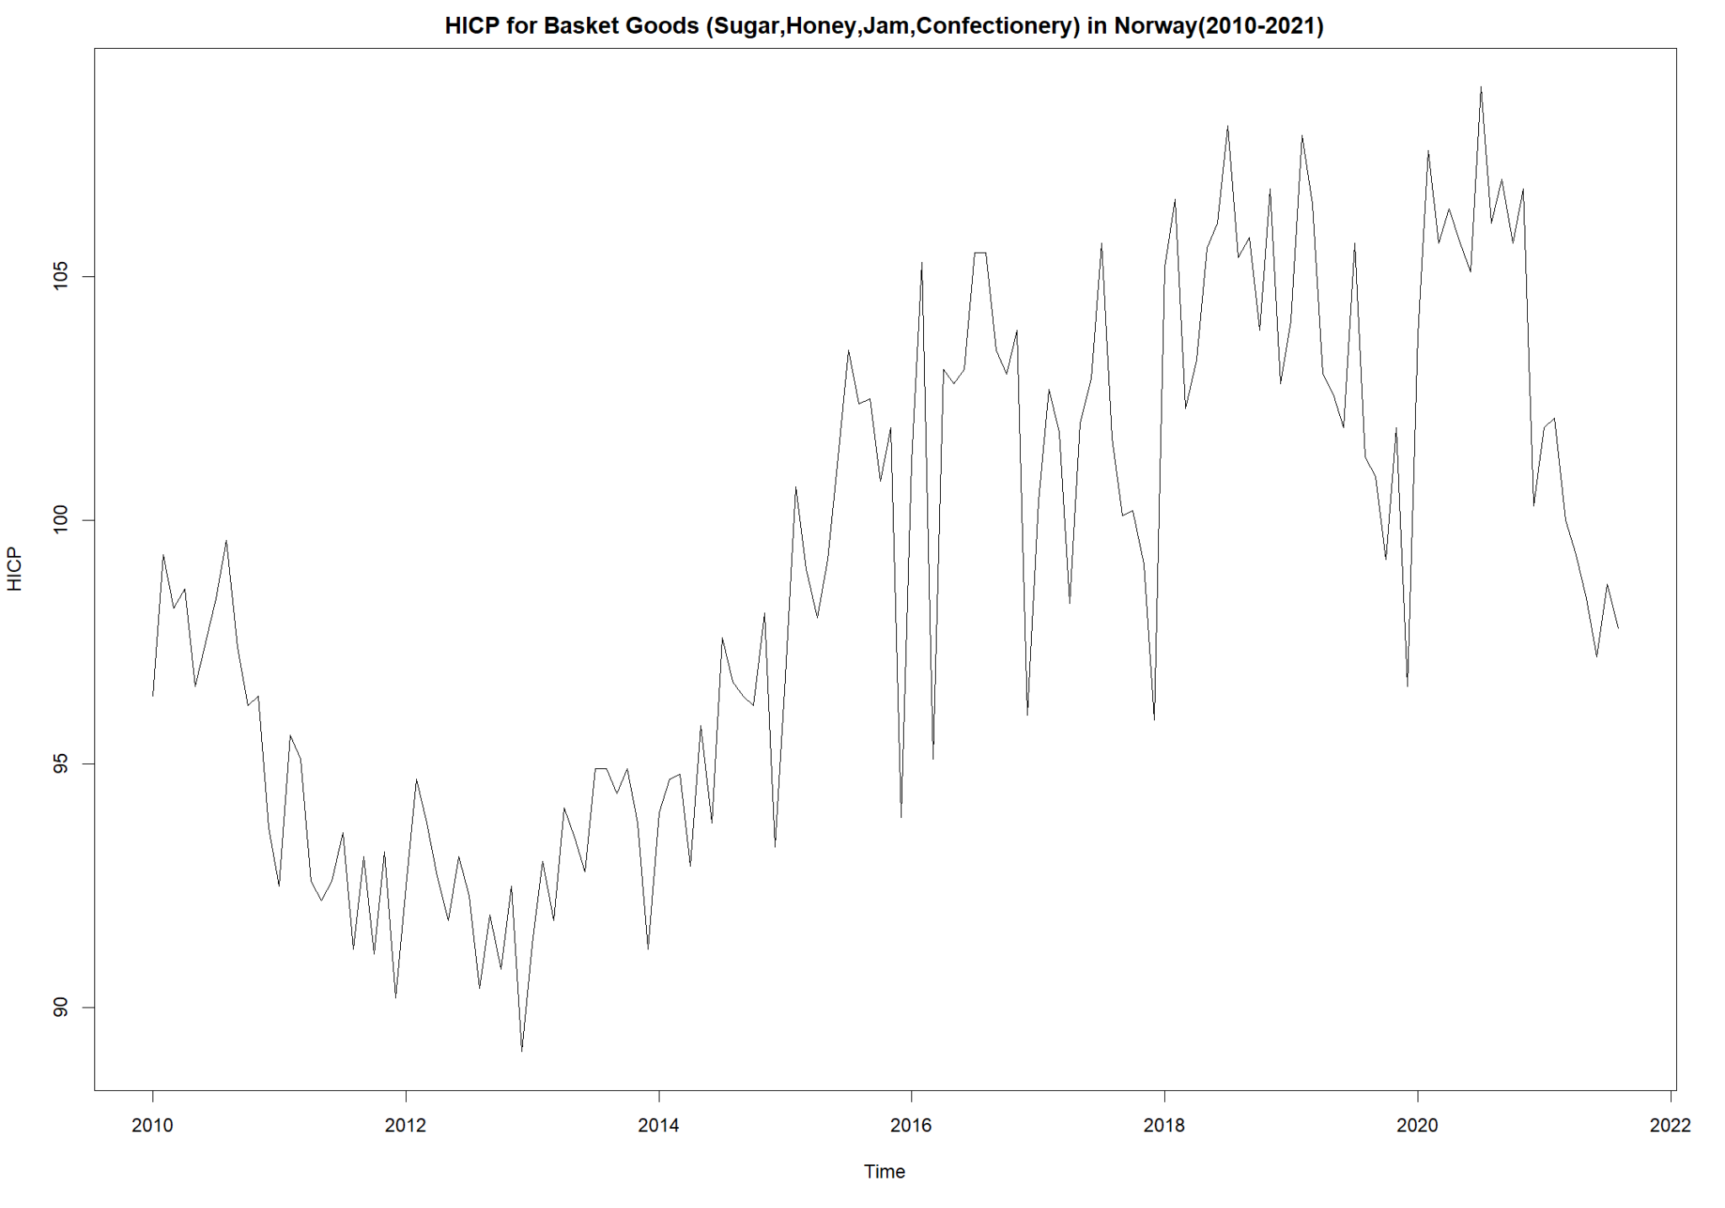
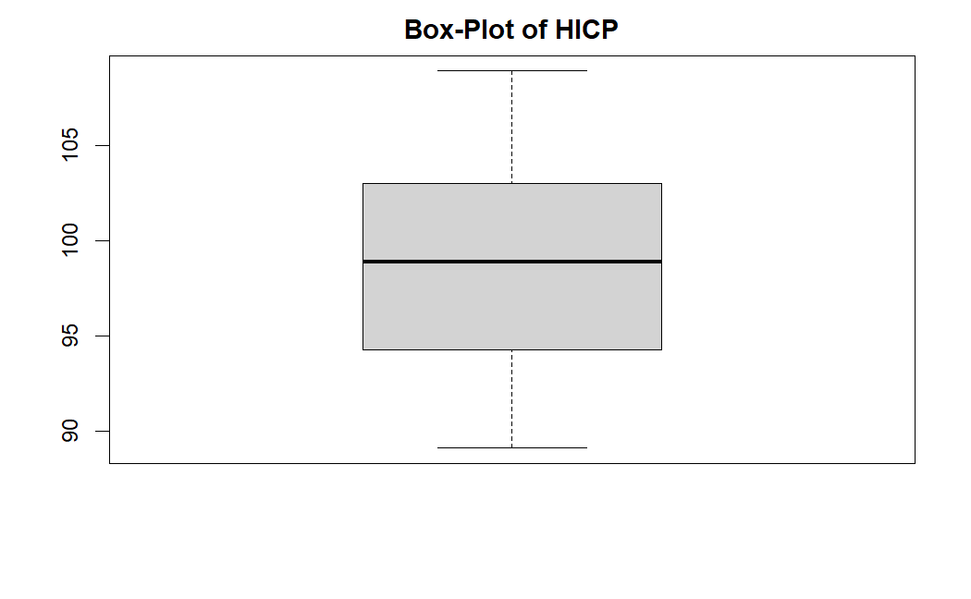
Data Exploration (2010-2021)
Notes:
Is there seasonality?
Do we need all of the data? => cut down from 2010-2021 to 2014-2021 due to a dip in 2013
What’s most relevant?

Slide 4
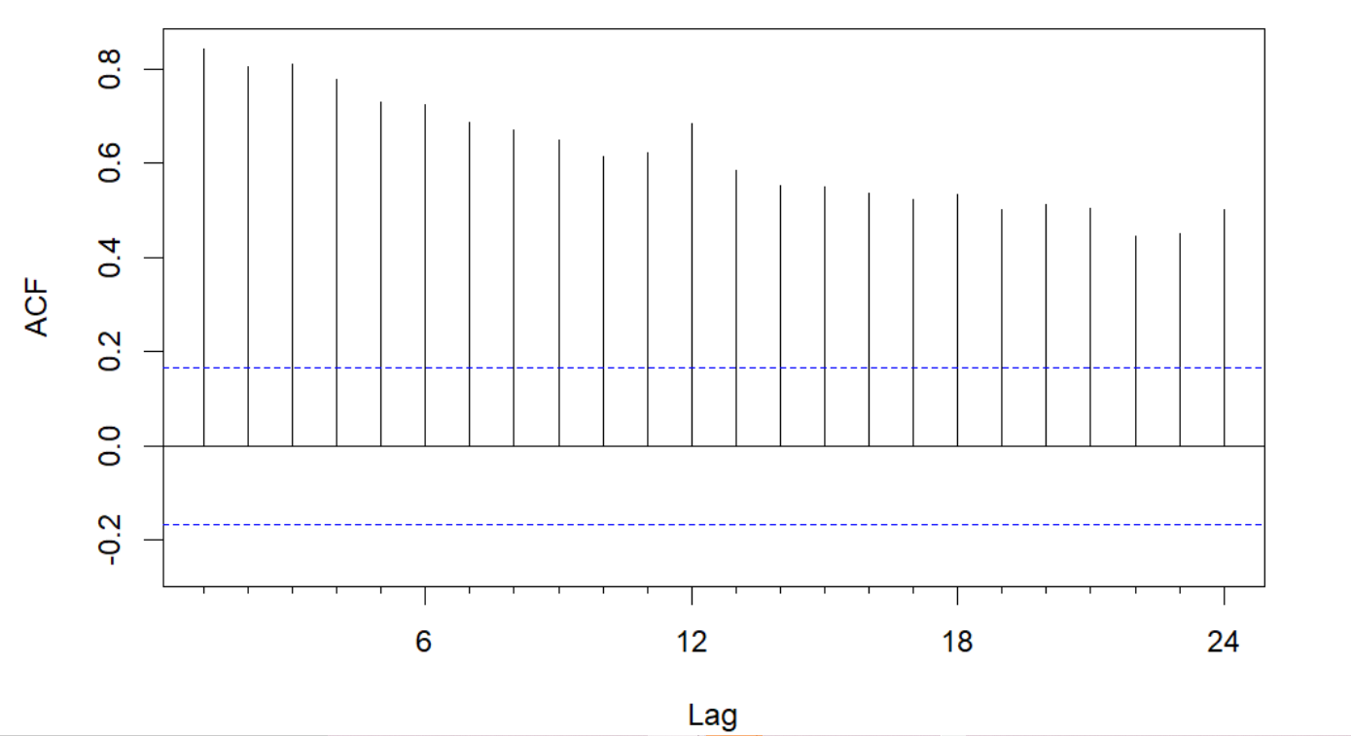
ACF of HICP (2010-2021)
Not much seasonality to be seen
Data looks highly correlated

Slide 5
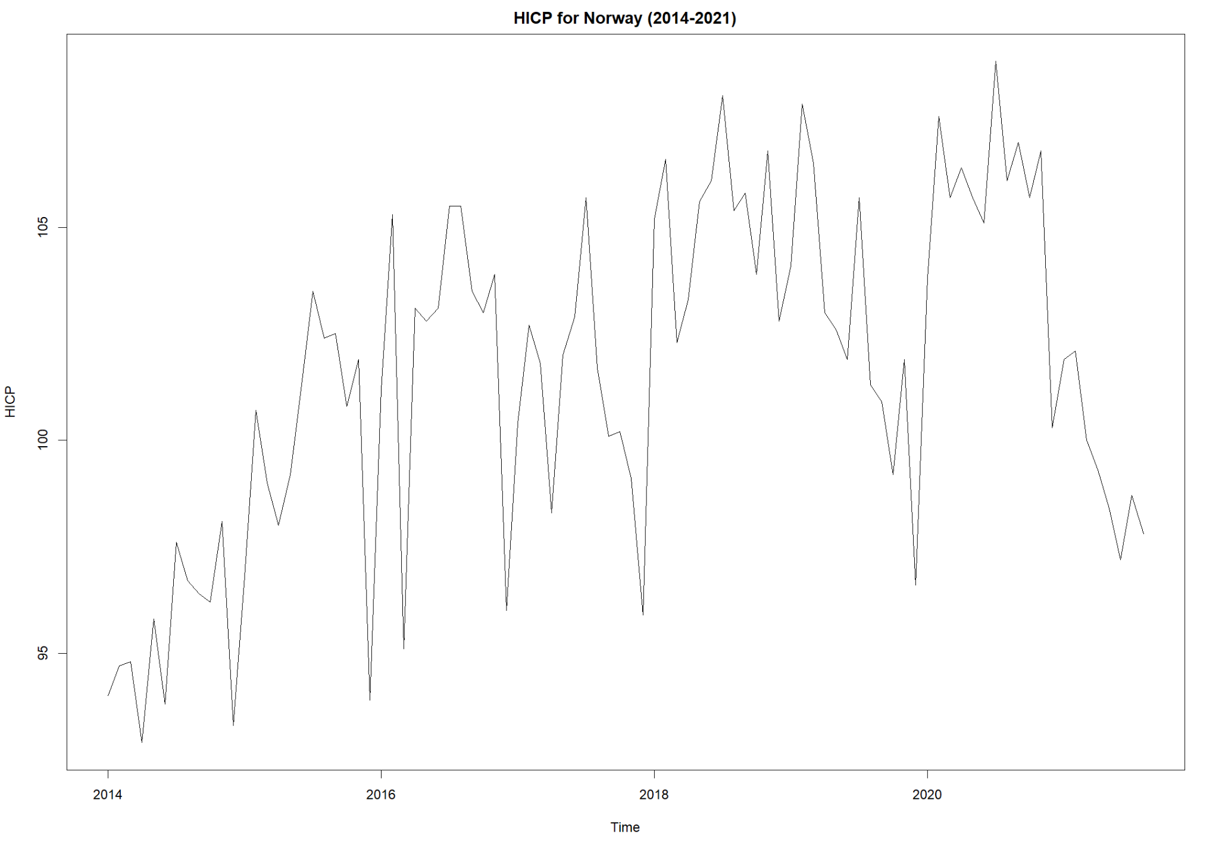
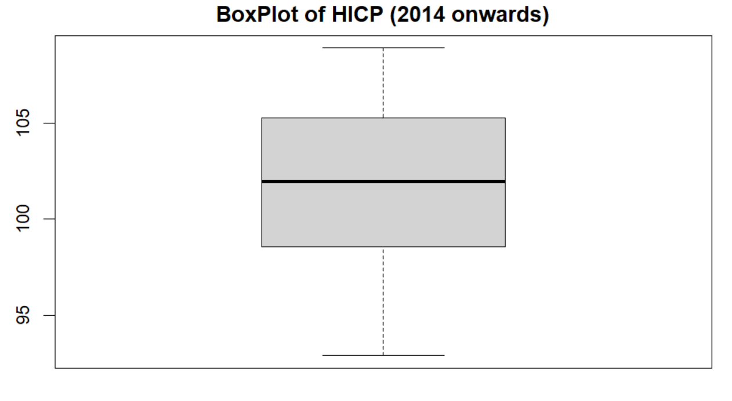
Updated Data (2014-2021)
Notes:
More relevant data
Better forecasting

Slide 6
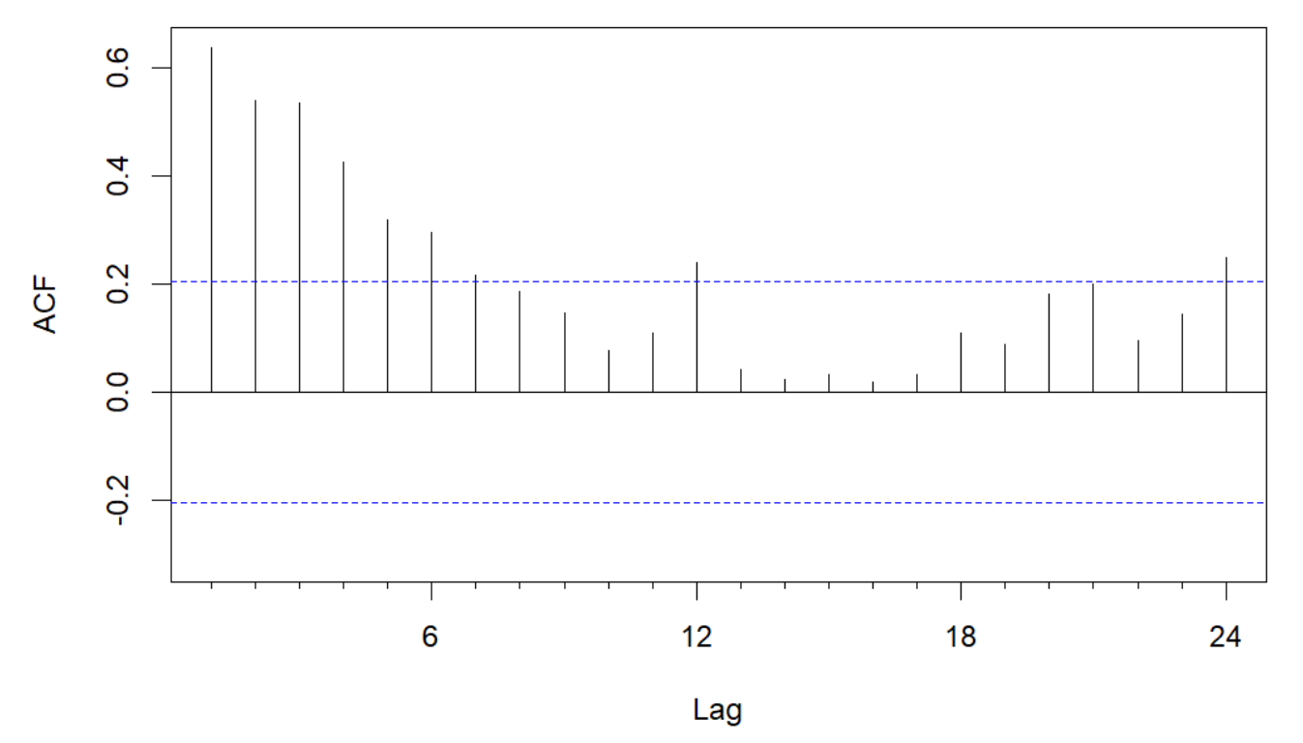
ACF of HICP (2014-2021)
Can see some seasonality here
Significant lags can be seen
Time Series data shows index dipping in Dec every year

Slide 7
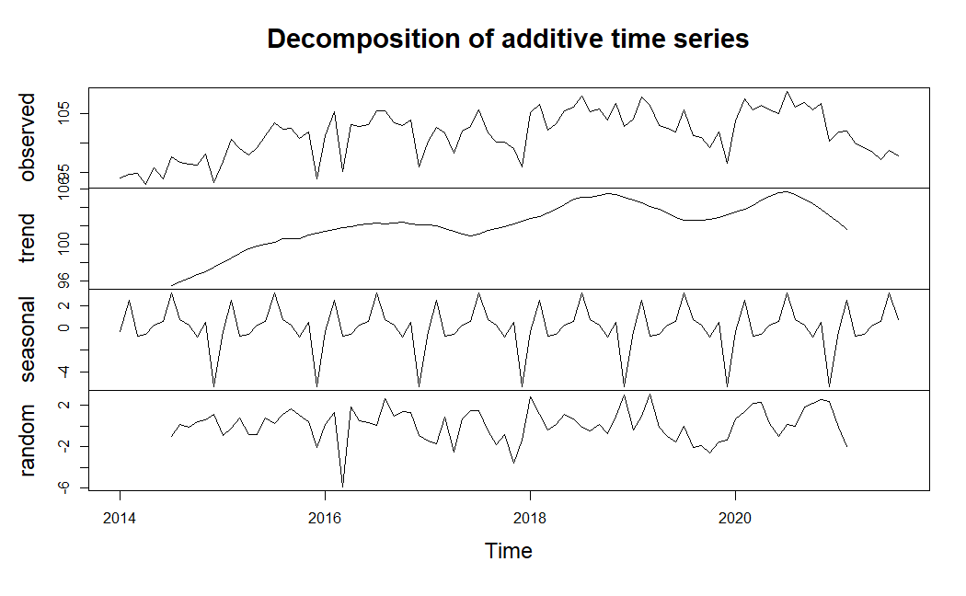
Decomposition of Time Series

Slide 8
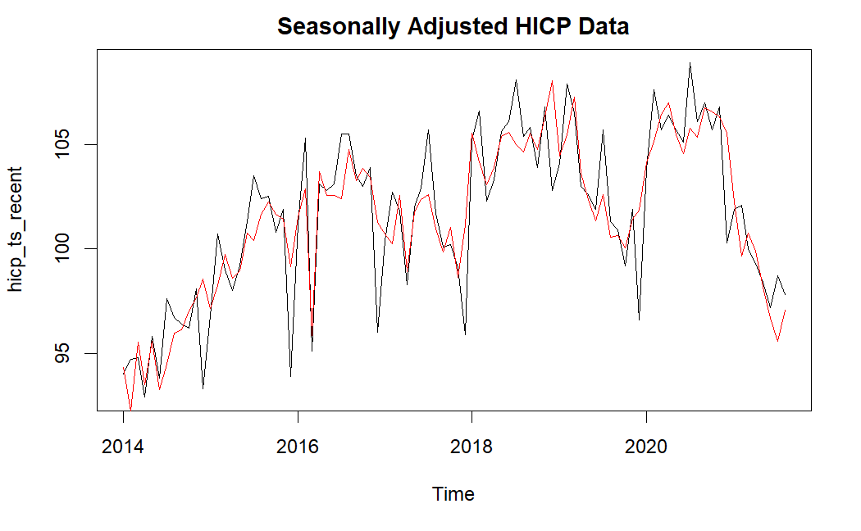
Seasonally Adjusted HICP

Slide 9
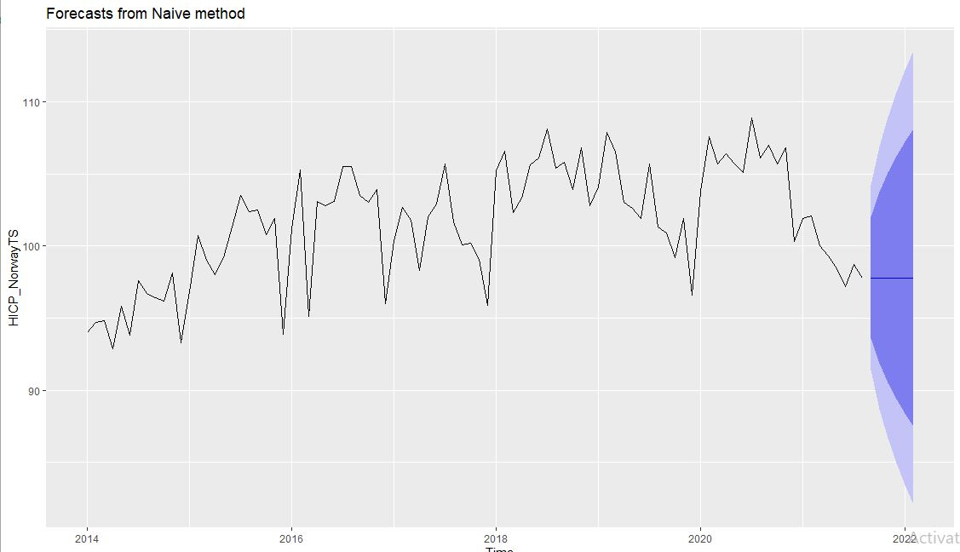
Naive Forecasting
We start with the simplest of forecast first which is Naive Forecasting.
Naive Forecasting principle considers the latest data points to be most relevant

Slide 10
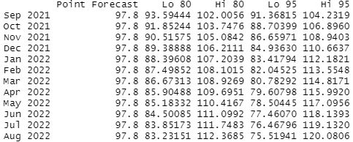
Naive Forecast

Slide 11
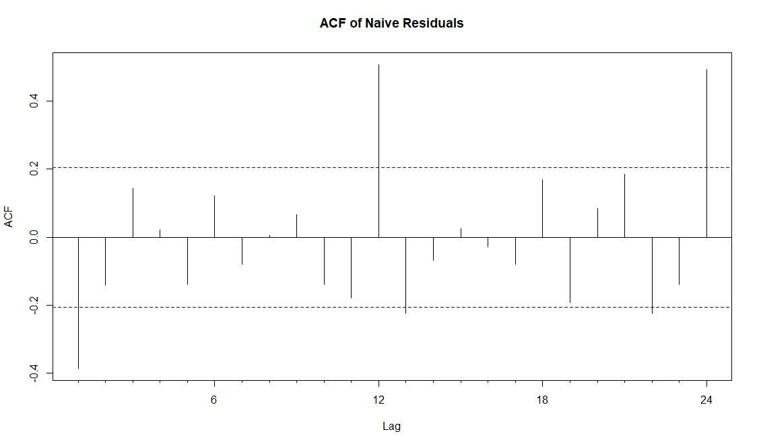
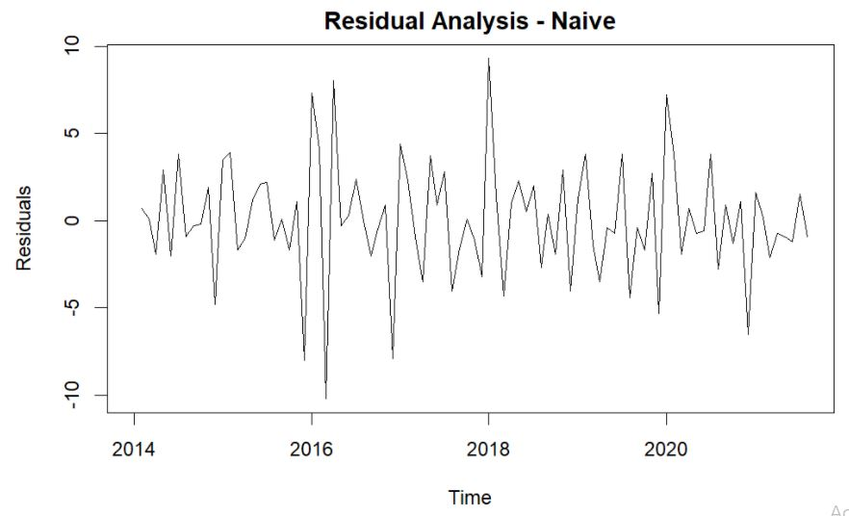
Residual Analysis of Naive

Slide 12
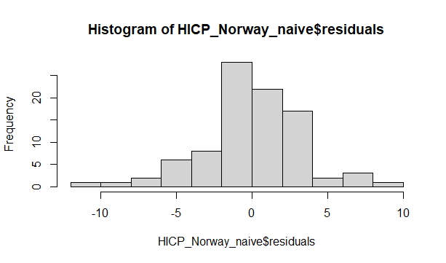
Histogram of Naive Residuals

Slide 13
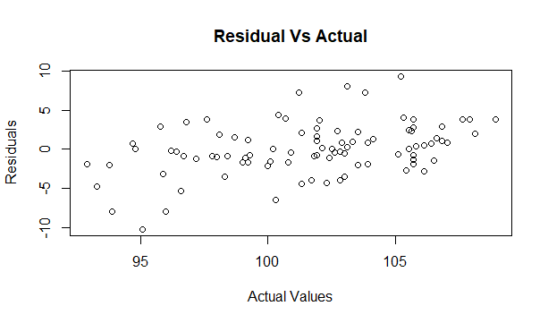
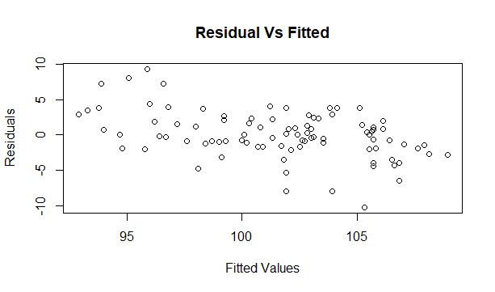
Residual Vs Actual and Residual Vs Fitted

Slide 14
Accuracy of Naive Model
ME RMSE MAE MPE MAPE MASE
Training set 0.04175824 3.281617 2.43956 -0.009851831 2.415338 0.6313971

Slide 15
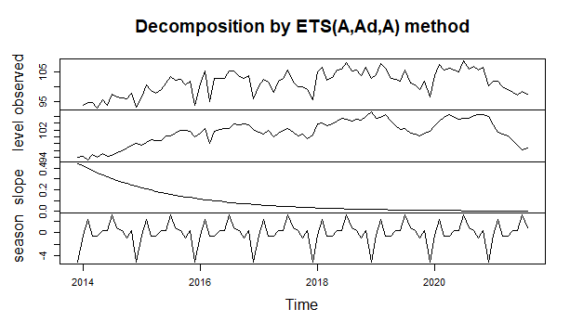
ETS Forecasting
Exponential smoothing breaks down the data into its components such as seasonality, trend and noise.

Slide 16
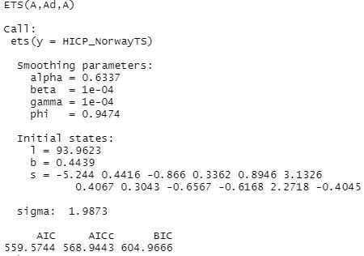
Smoothing Factor of ETS

Slide 17
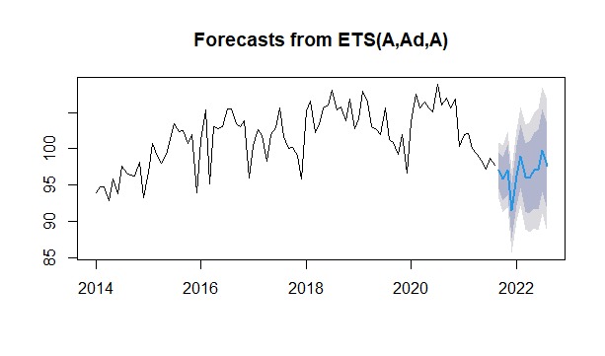
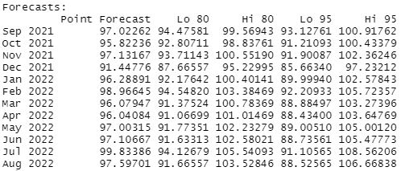
ETS Forecasting

Slide 18
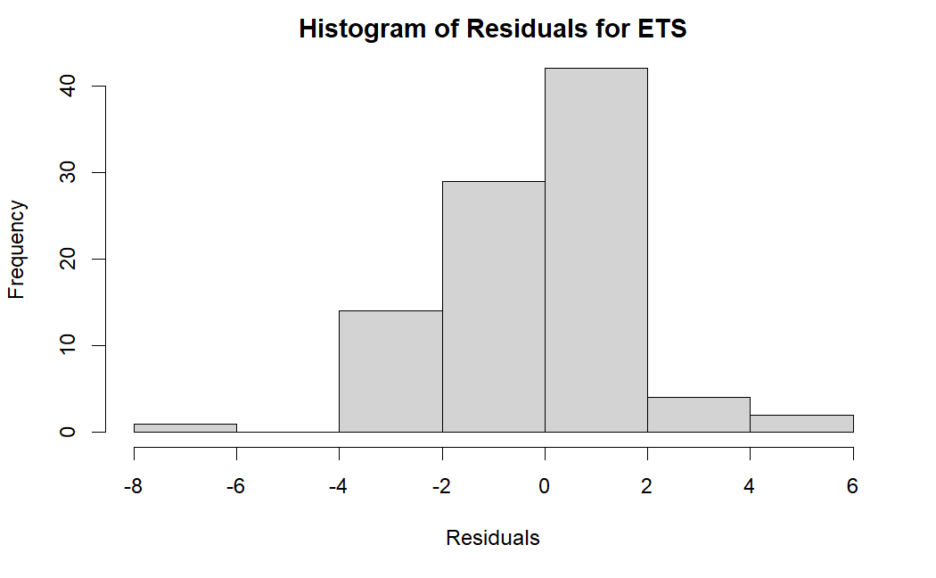
Histogram of Residuals for ETS

Slide 19
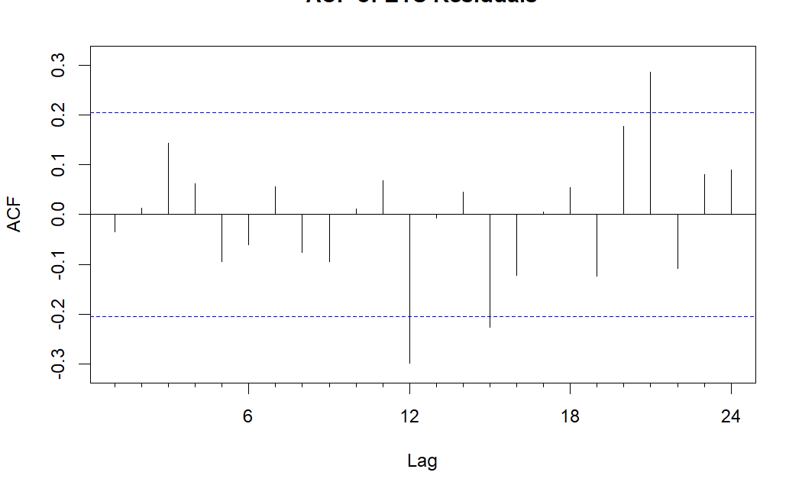
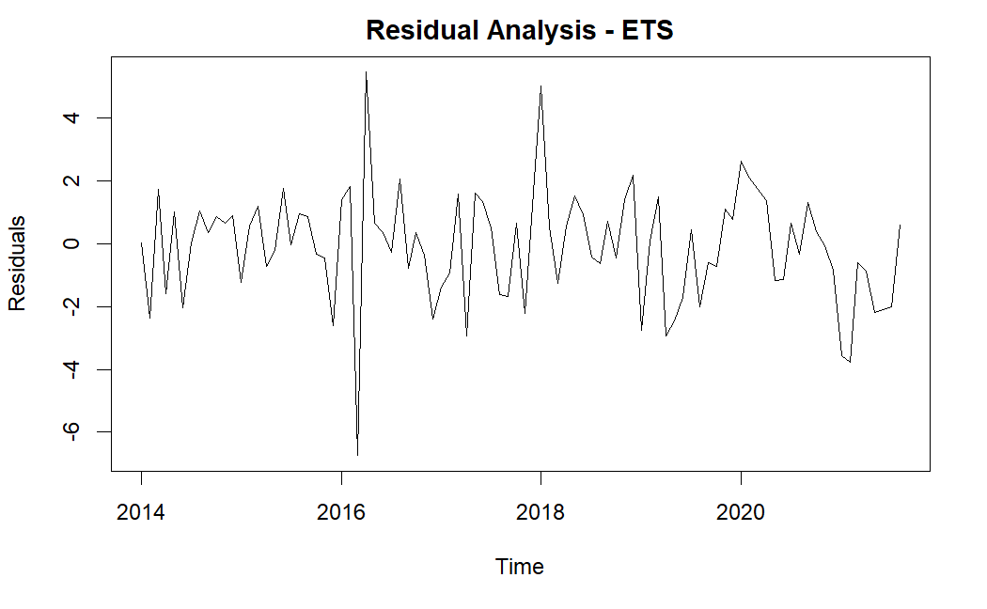
Residual Analysis of ETS

Slide 20
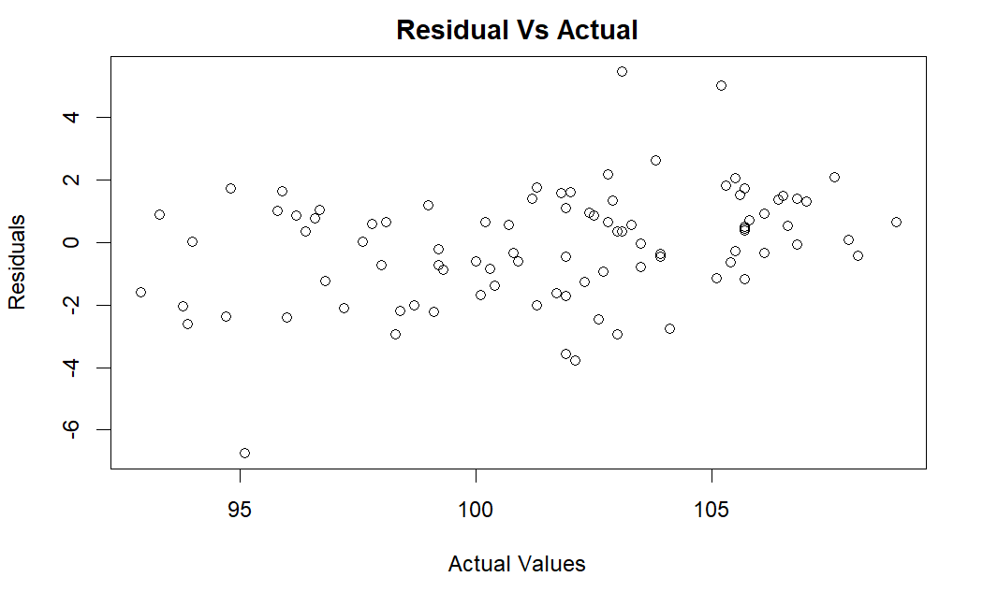
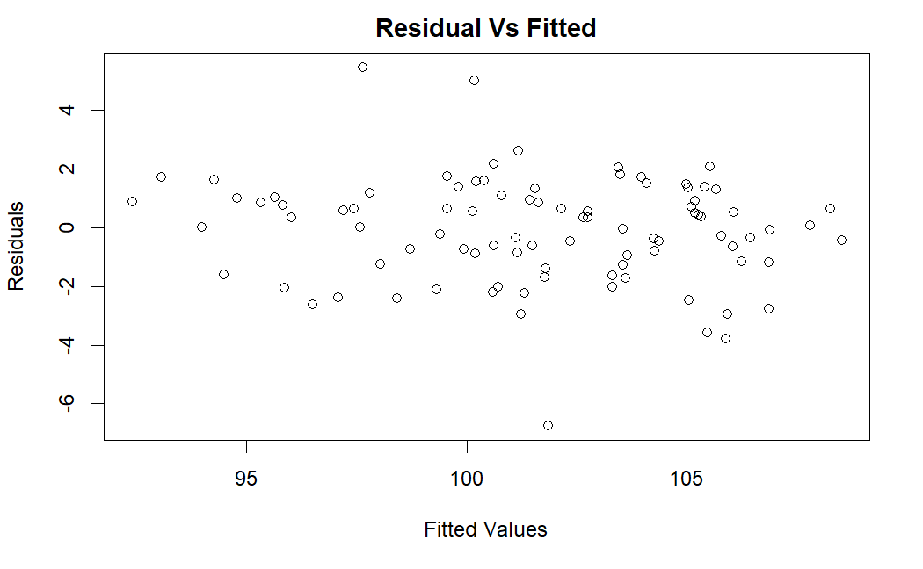
Residual Vs Actual and Residual Vs Fitted

Slide 21
Accuracy Measure - ETS Model
ME RMSE MAE MPE MAPE MASE
Training set -0.08966673 1.794307 1.375361 -0.1109913 1.363334 0.3559654
The RMSE and MAE values are comparatively better than NAIVE Model but it can improved using other models.

Slide 22
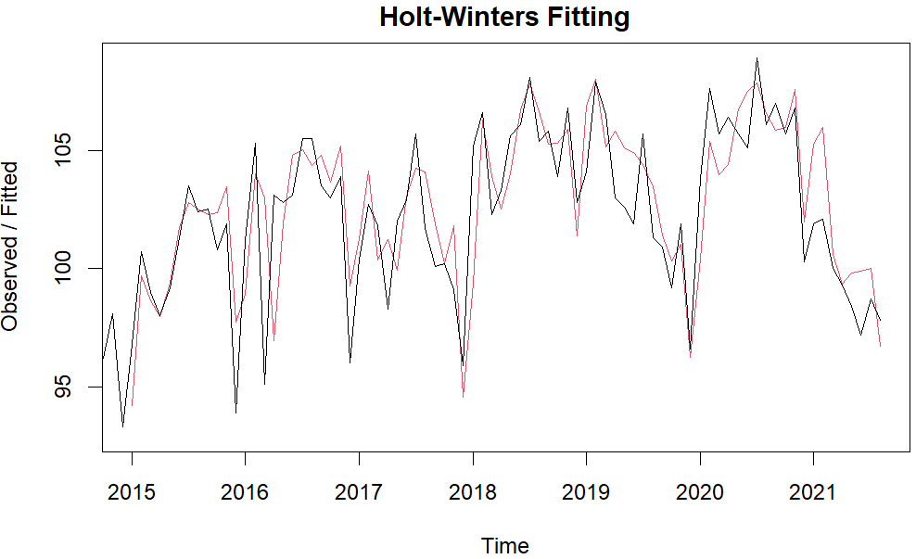
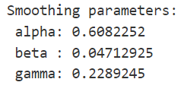
HOLT-WINTERS
The fit seems much better than previous models.
Takes into account level, trend and seasonality component

Slide 23
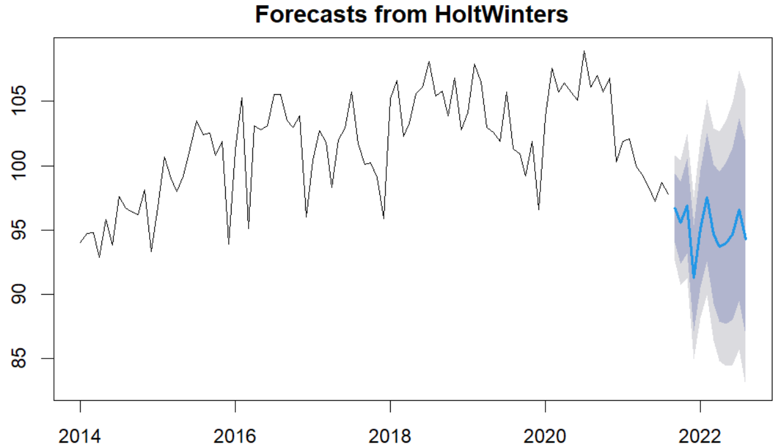



Forecast from Holt-Winters
2021 :
2022 :

Slide 24
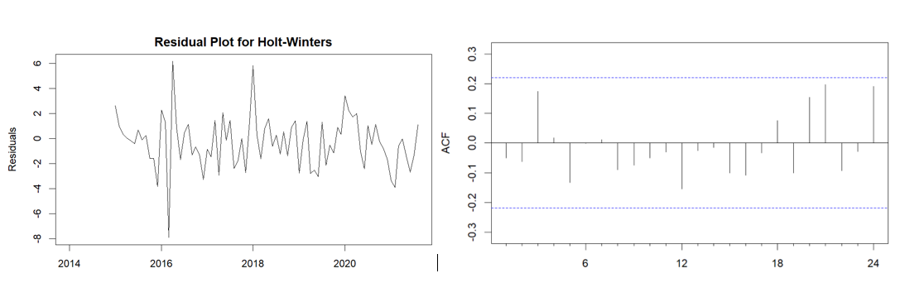
Residual Analysis of Holt-Winters

Slide 25
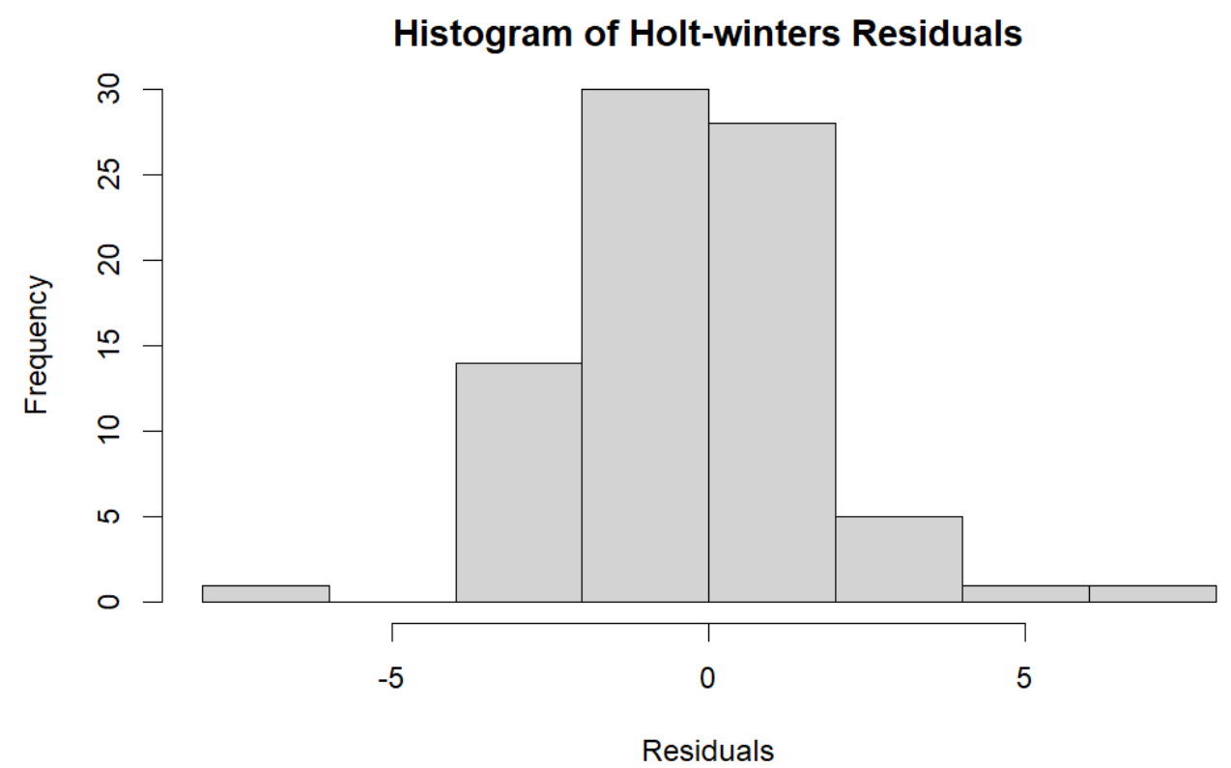

Slide 26
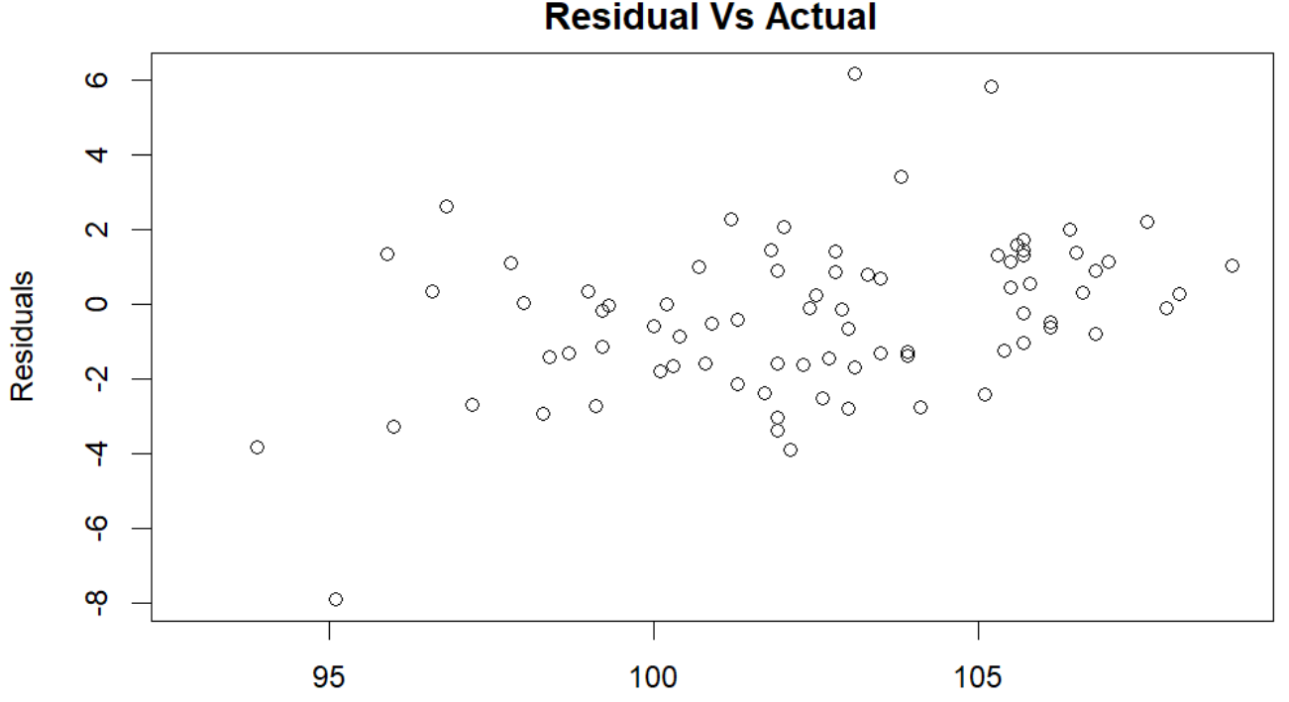
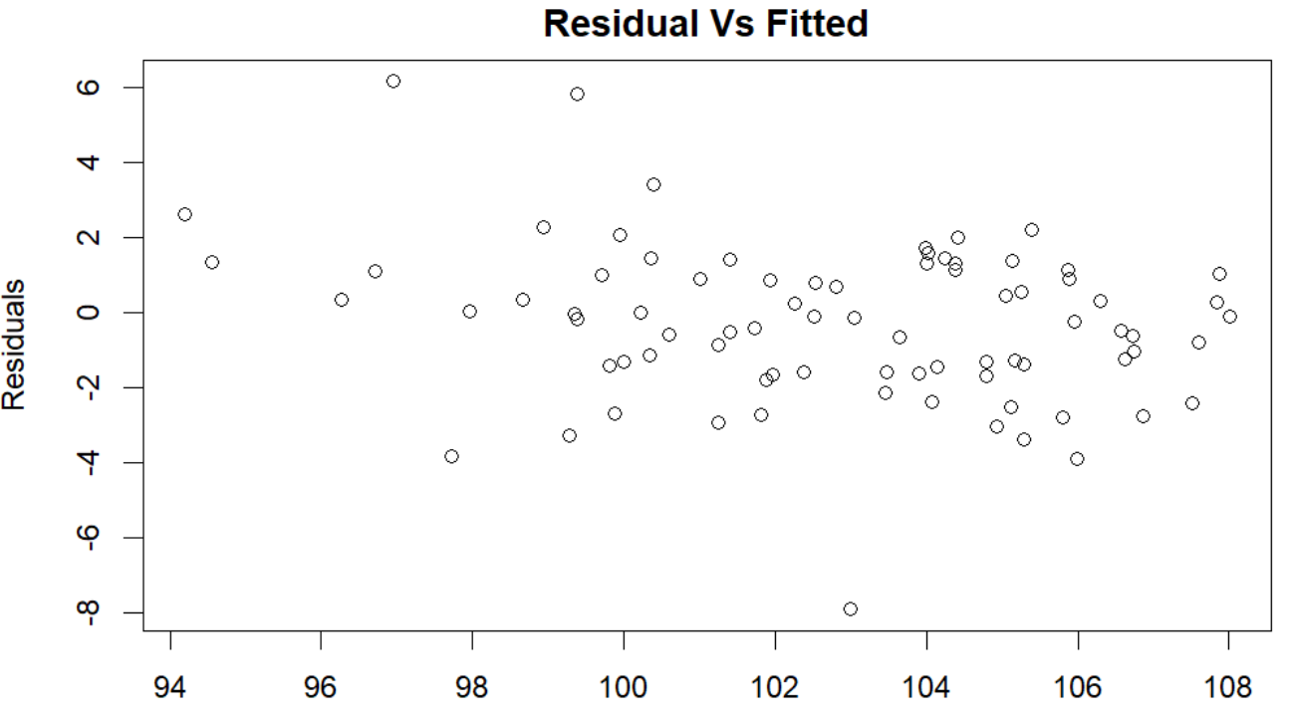
Residual Vs Actual Residuals VsFitted

Slide 27
Accuracy Measures (Holt-Winters)
RMSE and MAE look much better than Naive but could be better when compared to ETS
The ACF looks much better than ETS and Naive

Slide 28
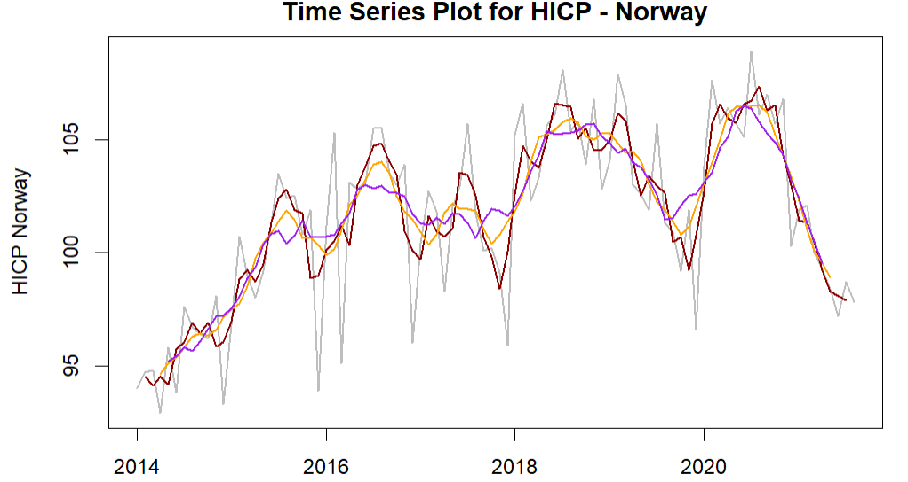
Simple Moving Averages
Order 3 (Red) plot follows the actual data (Grey) closely
Order 6 (Orange) plot is somewhat smoother compared to Order 3
Order 9 (Purple) is smoothest.

Slide 29
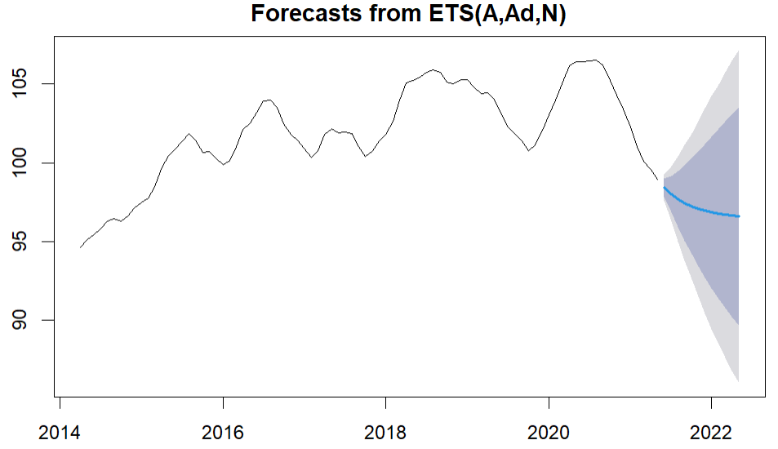



Forecast Using Moving Averages
2021:
2022:

Slide 30
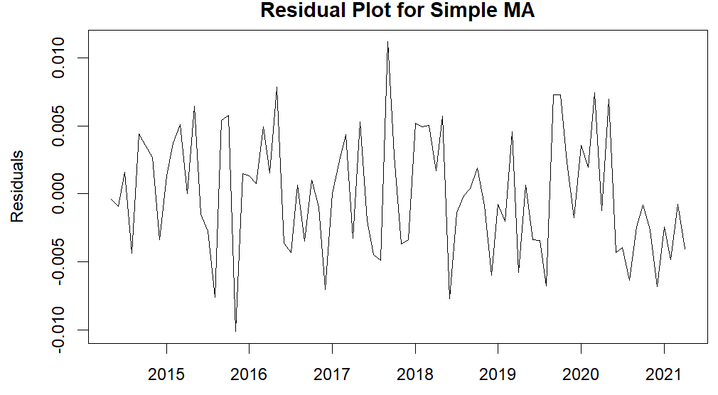
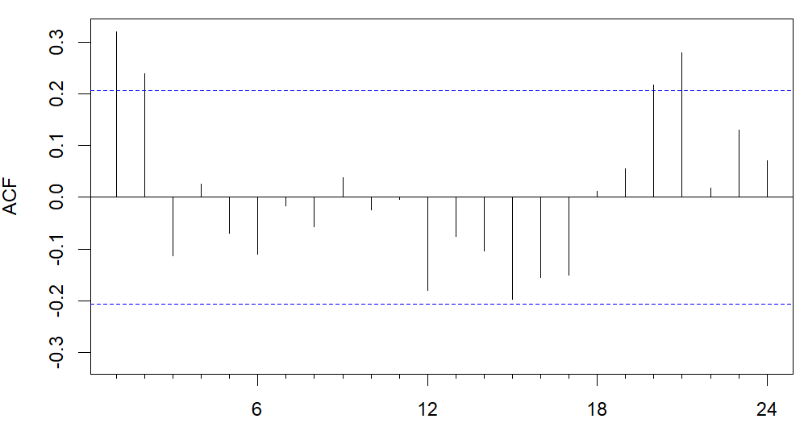
Residual Analysis of Moving Averages

Slide 31
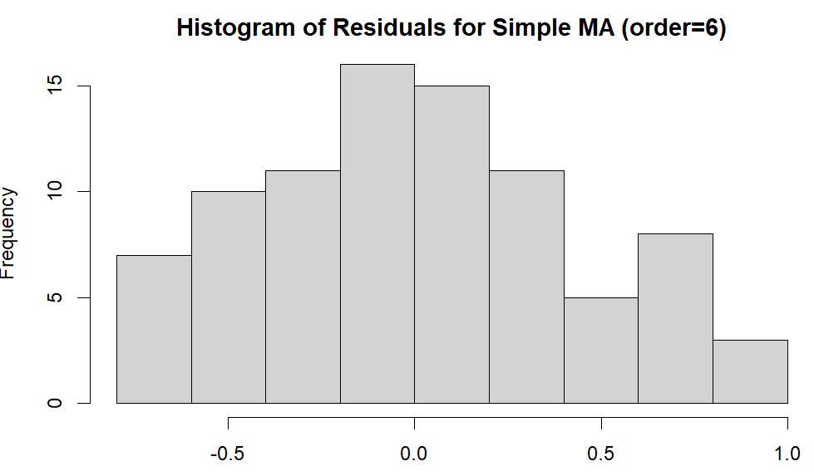

Slide 32
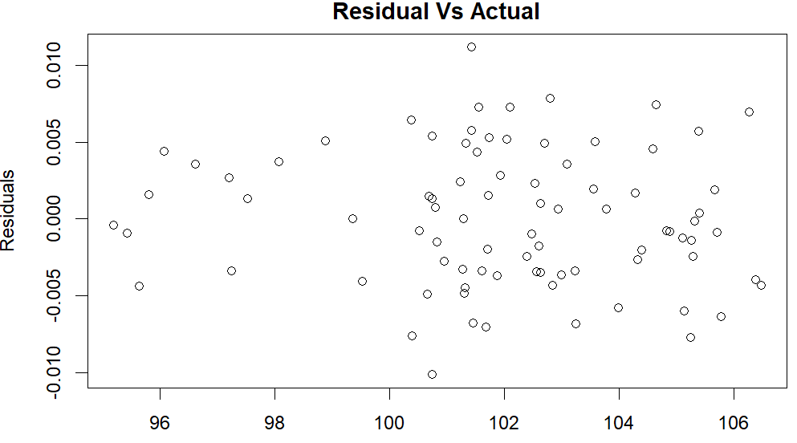
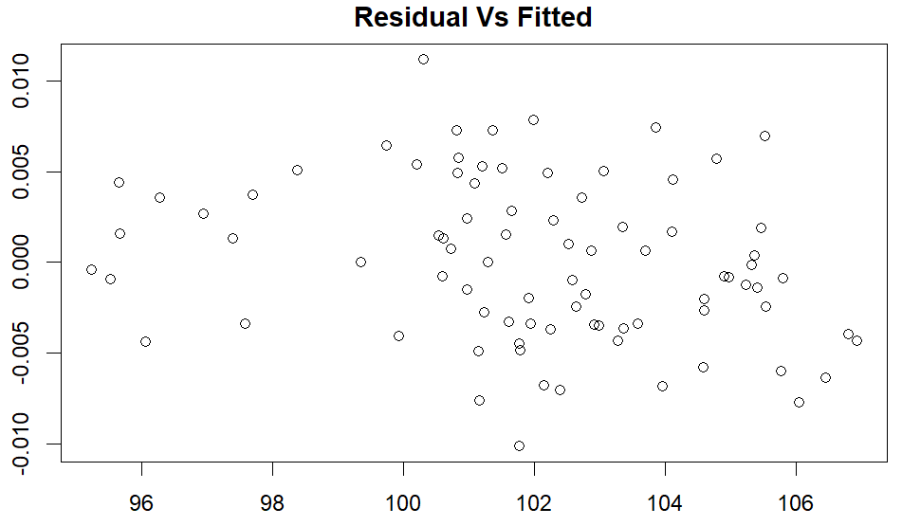
Residual Vs Actual Residuals Vs Fitted

Slide 33
Accuracy Measures for MA
Order= 9
Order= 6
Order= 3

Slide 34
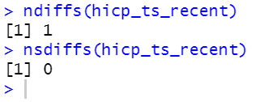
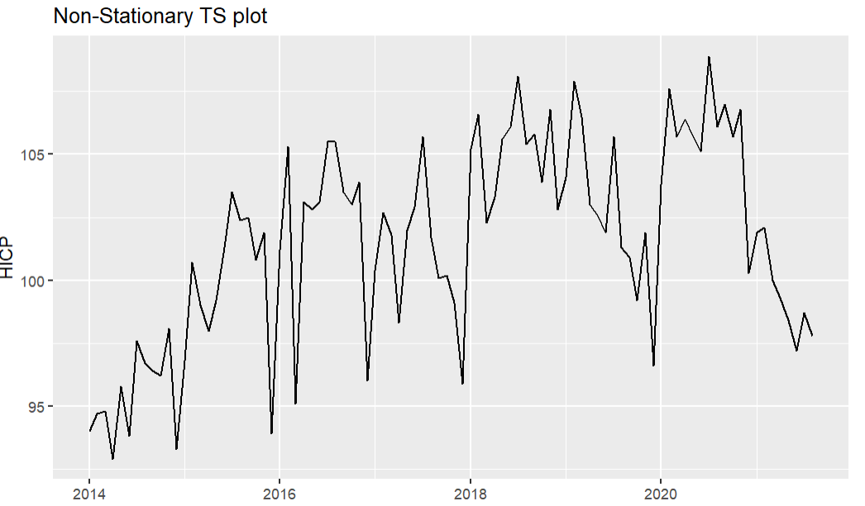
ARIMA
Differences needed to make data stationary = 1
Seasonal difference required = 0
d=1

Slide 35
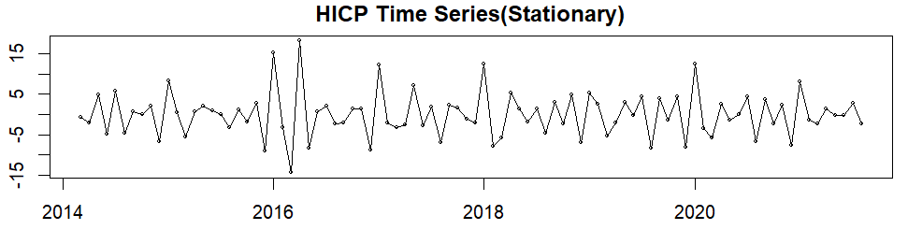
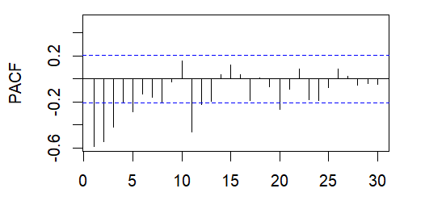
Plot of Stationary Data after Differences
PACF shows significant lag at 12

Slide 36
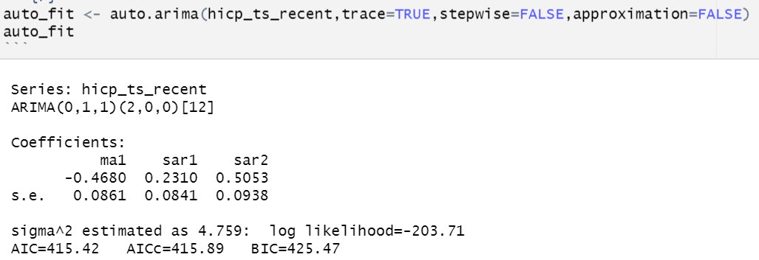

Fitting the ARIMA Model
Non-seasonal component : MA1 model
Seasonal component : AR1 and AR2 model
Significant spike : Lag 12

Slide 37
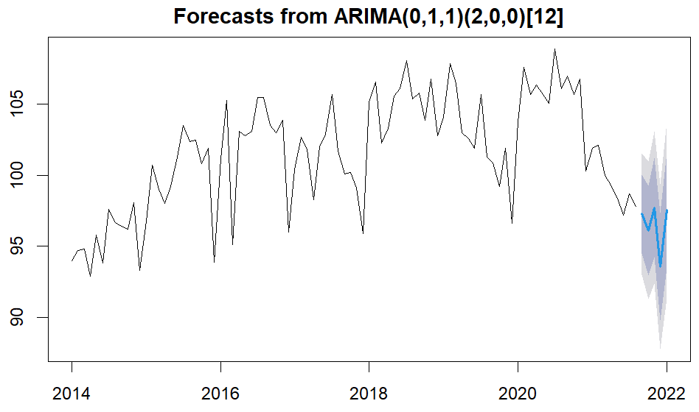


Forecast Using ARIMA
2021 :
2022 :

Slide 38
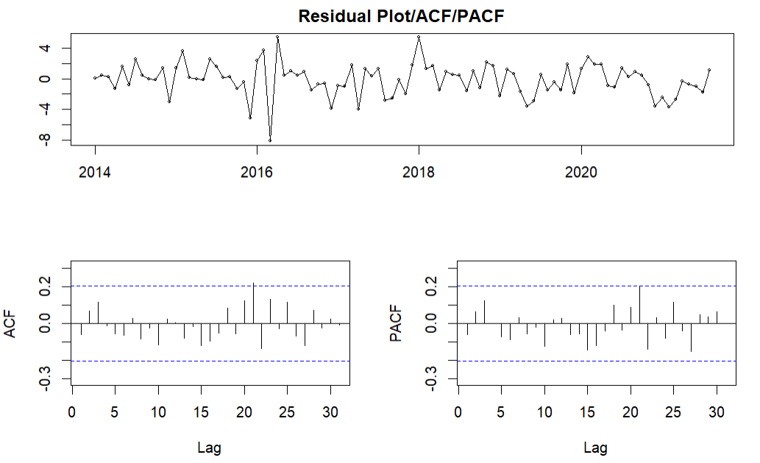
Residual Analysis of ARIMA

Slide 39
Accuracy Measures for ARIMA
Accuracy measures are comparable to that of Holt-Winters
ACF of residuals looks promising

Slide 40
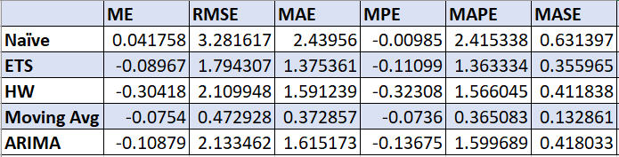
Conclusion
Moving Averages show the best accuracy measures among all the given models
But ACF of residuals for MA was not satisfactory
In comparison, Holt-Winters and ARIMA both show comparable accuracy measures while the ACF of residuals look satisfactory too.

Slide 41

THANK YOU!!

